Slide 1
MLB Statistical Analysis
Evan Adinolfe
(All stats from Fangraphs)

Slide 2
Analysis Overview
I’ll be using advanced batting stats from Fangraphs to determine which hitters will have sustained success throughout the 2025 season. Through creating a database with these stats, I will highlight certain players’ impressive performance.
Using major stat categories, I will pick the MVP of each league. Then, I will create a predictive model in R Studio to award an MVP of each league.

Slide 3
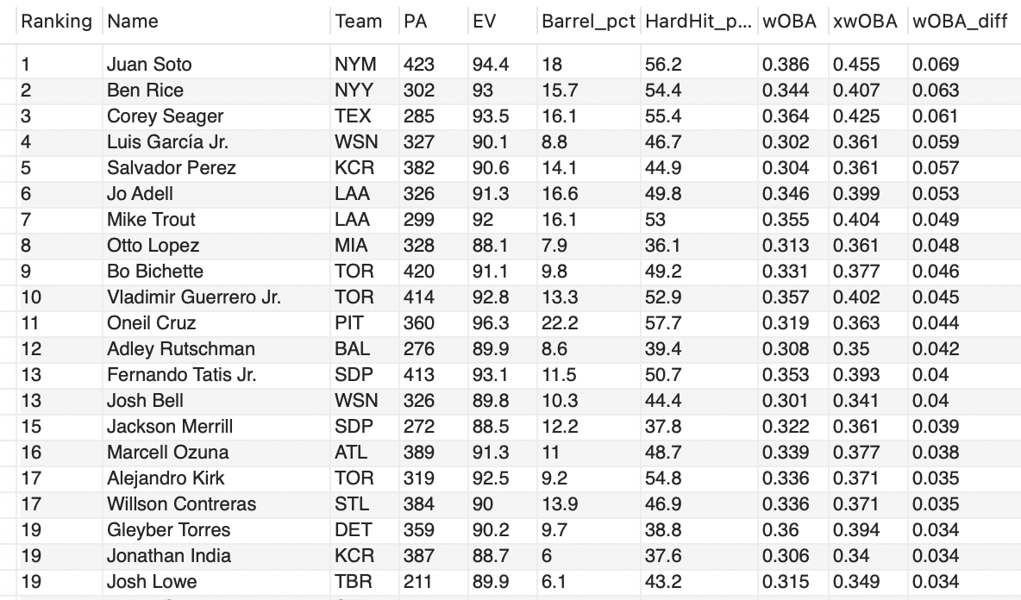
Unluckiest Players by xwOBA
Players with at least a .300 wOBA, ranked by xwOBA and wOBA difference. Exit velocity, barrel rate, and hard hit rate also give insight into whether the player is hitting the ball hard, too.
Some think Juan Soto is having a down year, but in reality, he’s the most unlucky player in baseball. He has the greatest xwOBA and wOBA difference, and he ranks near the top of the list in batted ball metrics.
Ben Rice might only be known by Yankee fans right now, but MLB fans will learn about him soon. Rice has a 63 point difference between expected and actual wOBA. He has an average exit velocity of 93, and a 15.7% barrel rate. The stats say Rice should be an elite hitter, and it’s only a matter of time before the on-field results start to show.

Slide 4
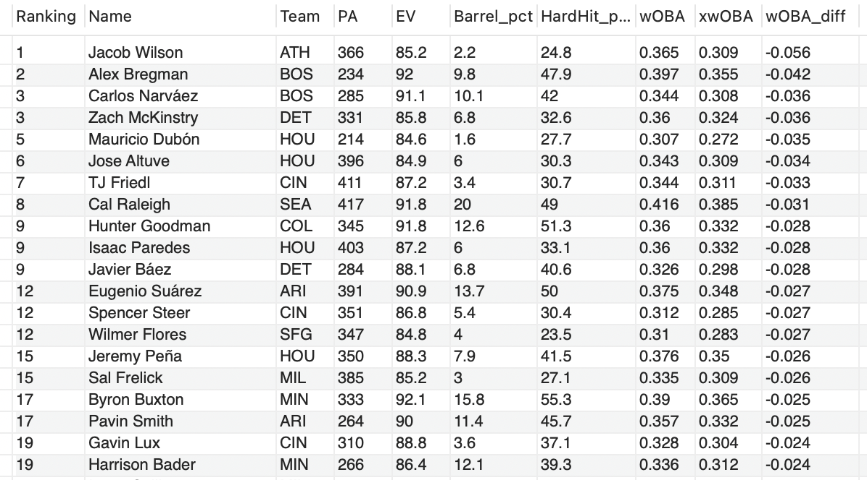
Overperforming Players by xwOBA
A’s rookie shortstop Jacob Wilson took the league by storm in the first half, but his batted ball data and expected wOBA say differently. His xwOBA is 56 points lower than his actual wOBA, the largest difference in the league. His 2.2% barrel rate is very low, suggesting he can’t maintain his .332 batting average. Hitting for contact may be Wilson’s game, but the stats show his lack barrels won’t be sustainable over a full season.
Javier Baez has had a nice comeback season after looking like he could be designated for assignment soon. Baez was even named an All-Star starter, but I’m not sold on his performance for the rest of the year. He has an expected wOBA below .300, and his barrel rate and exit velocity are below average.
Almost all of these players are having a career year, so does that mean they’re all getting lucky? Not exactly. Players with large differences in expected and actual wOBA and poor batted ball data are getting lucky, and their results will regress soon. However, players like Alex Bregman,
Byron Buxton, Eugenio Suarez, Hunter Goodman and Cal Raleigh are all having their best seasons, but their batted ball metrics look good. A high exit velocity, barrel percentage, and hard hit rate leads to sustained success. These players might be getting some batted ball luck, so their results might come down a bit, but I expect them to still have great seasons.

Slide 5
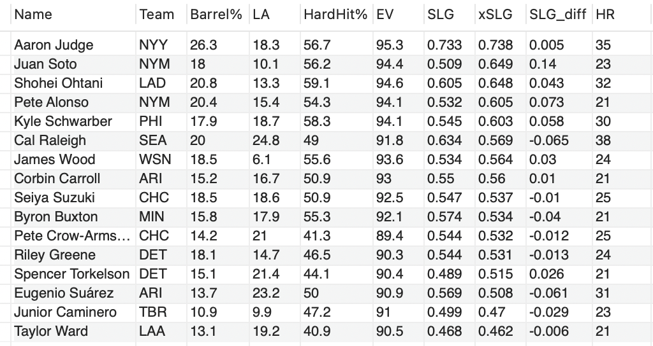
Power Hitters
Players with at least 20 home runs, sorted by xSLG. The goal is to use batted ball statcast metrics and expected slugging percentage to predict which hitters will continue their home run production in the second half of the season.
Note: SLG_diff is xSLG – SLG

Slide 6
Best Power Hitters: Takeaways
Cal Raleigh: Regression?
Juan Soto: Bad Luck
Standout Stats:
Raleigh has had an unreal season, especially for a catcher, launching a league leading 38 home runs. However, he has one of the lower exit velocities and barrel rates among the top power hitters, and his xSLG is 65 points lower than his actual SLG. Raleigh produces most of his home runs from his massive 24.8 degree launch angle. Due to his exit velocity and barrel rate being much lower than other top power hitters, I don’t expect Raleigh to keep up his historic home run pace.
Soto’s batted ball metrics are outstanding. Among players with 20 home runs, he ranks 3rd in exit velocity and 4th in hard hit rate. His xSLG is an absurd 140 points higher than his actual. Soto’s only problem? He hits too many ground balls. If he increases his 10.1 degree launch angle, I expect Soto to easily reach 40 home runs.
James Wood has a 6.1 degree launch angle, yet still has 23 home runs. Imagine what the 22 year-old can do if he hits more fly balls.
Aaron Judge leads the league with a ridiculous 26.3% barrel rate and 95.3 exit velocity. No one is hitting the ball like him, and his xSLG is actually 5 points higher than his league-leading .733 SLG. I expect Judge to continue his historic season and eventually overtake Raleigh’s home run total.

Slide 7
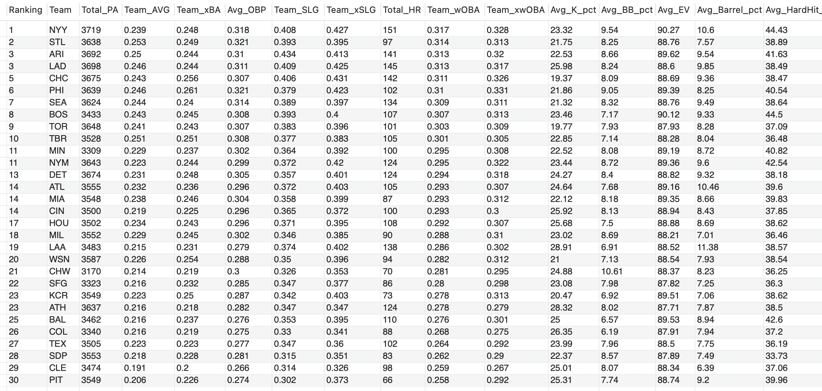
Stats by Team
(sorted by wOBA)

Slide 8
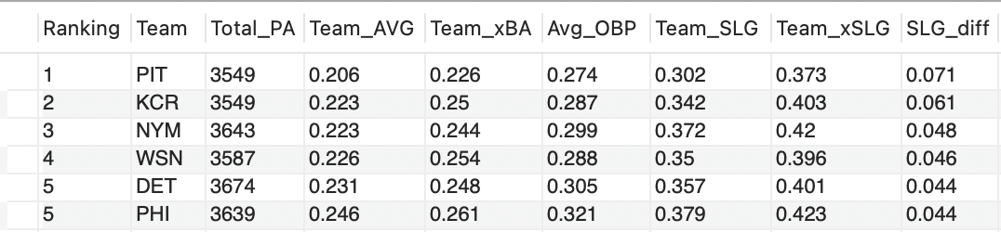
Stats by Team: Takeaways
Best Offense: Yankees
Red Sox on the Rise
The New York Yankees lead the MLB in home runs and are top 3 in OBP, wOBA, and SLG. Their batted ball metrics are elite as well, since they are top 3 in exit velocity, barrel percentage, and hard-hit rate. The Yankees walk and hit the ball harder than anyone in the MLB, at a high rate. This is a formula to the best offense in baseball for the rest of the season.
The Red Sox have been one of the better offenses so far, ranking top 10 in batting average, SLG, and wOBA. This is a good offense, but their batted ball stats suggest Boston should be even better. They are second in team exit velocity, ninth in barrel percentage, and first in hard hit percentage. With these statcast numbers, the Red Sox are hitting the ball hard at the highest rate in MLB, but they’re hitting into some bad luck. With Alex Bregman returning from injury and number one prospect Roman Anthony starting to settle in, the Red Sox offense is going to push them to the playoffs.
Standout Stats:
The Cubs have the second lowest strikeout percentage, with a top 5 home run total. This is a recipe for future success.
The Pirates and Royals, two of the worst offenses in baseball, have the largest xSLG and SLG differences, suggesting they could be getting unlucky at the plate.

Slide 9
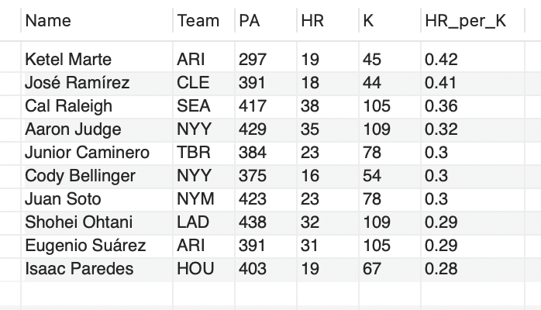
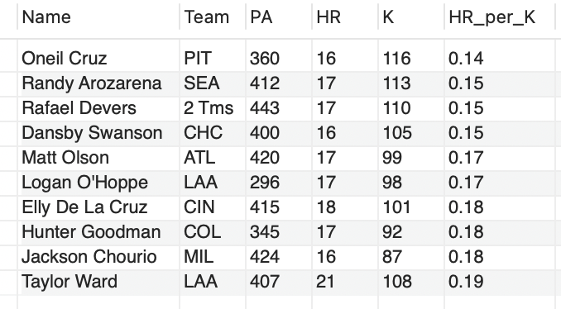
Home Runs per Strikeout
HR per K measures a player’s power relative to their strikeout numbers. Do their home runs outweigh their strikeouts?
Ketel Marte has the highest HR per K in baseball, limiting his strikeouts to just 45 with a strong home run total too. Jose Ramirez stands out in this area as well.
Judge and Ohtani are just outside the top 10 in strikeouts, but their immense home run power significantly outweighs it.
Second year Rays 3B Junior Caminero ranks 5th in HR per K. The rest of this list is veteran players, so this is impressive for Caminero.
Oneil Cruz has one of the highest bat speeds in baseball, but it hasn’t paid off well for him, as he ranks last in HR per K.
Rafael Devers has struggling ever since getting traded to the Giants. He hasn’t been hitting home runs at the same rate, leading to a low HR per K.
Some of these players may be hitting doubles instead of home runs. Matt Olson and Elly De La Cruz have a .468 and .495 SLG, so having a low HR per K is a little misleading for them.

Slide 10
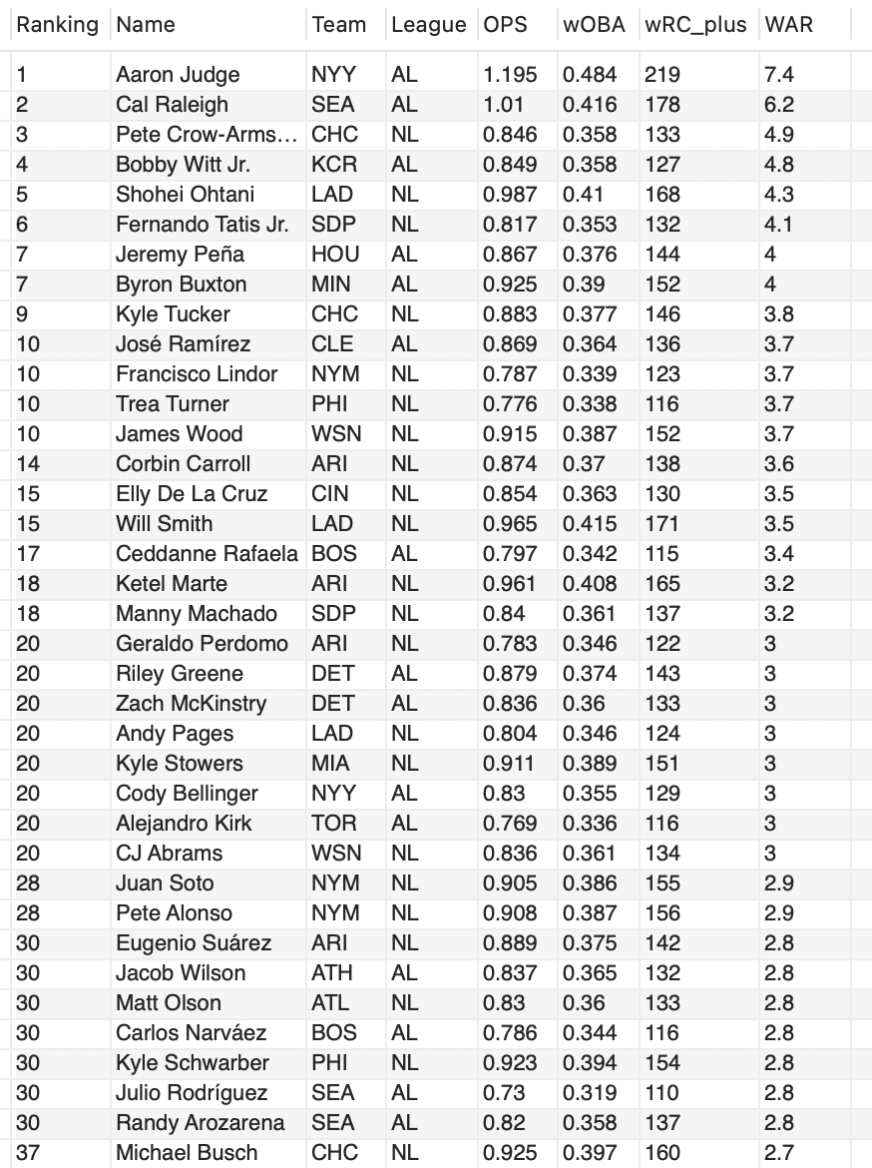
MVP Candidates
4 major stats to determine the MVP of each league:
WAR – values offense, defense, and baserunning combined into a cumulative number
wRC+ - offensive output relative to the rest of the league. League average offense is a value of 100.
wOBA – weighted on base average: assigns different weights to each on base event (single, home run, etc.)
OPS – very similar to wOBA but simpler, as it adds OBP and SLG together. Easy to understand, but since OBP and SLG use different denominators (PA vs AB), the stat is less accurate.
From these stats, I will rank the MVP candidates for each league. Then, I will create a model to pick the statistical-driven MVP.

Slide 11
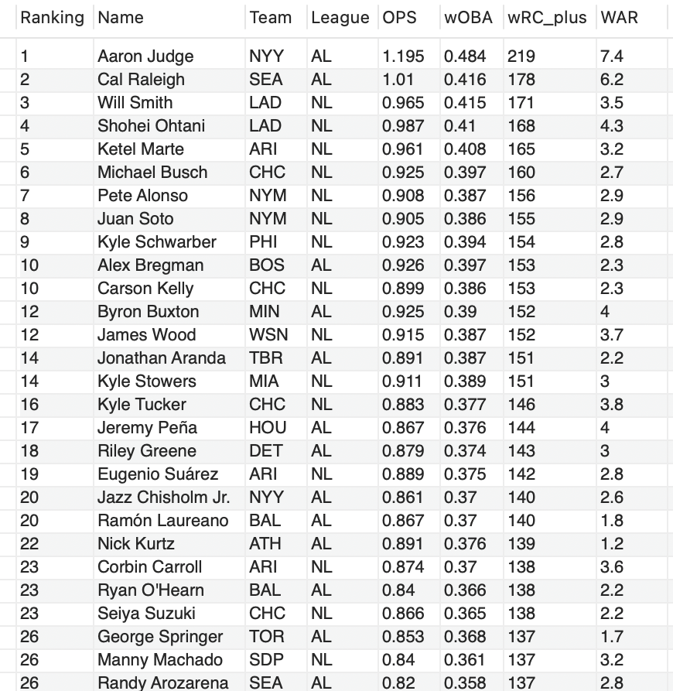
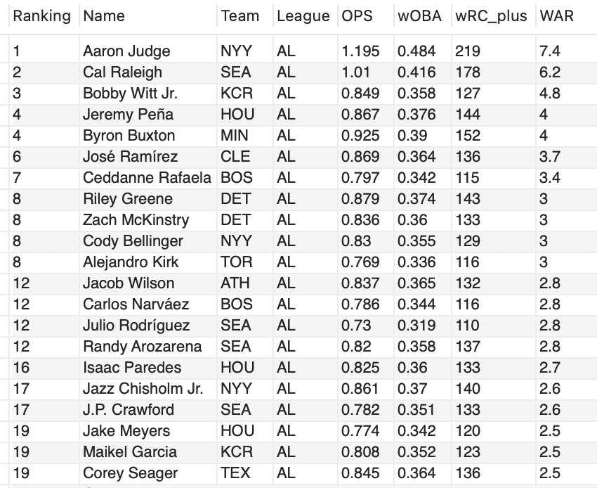
MVP Candidates: American League
Rankings by wRC+
1. Aaron Judge
2. Cal Raleigh
Judge leads the entire MLB in the 4 major stats I will use to determine MVP. Cal Raleigh ranks second in all of these categories, and Judge leads him by .185 OPS, .068 wOBA, 41 wRC+ and 1.2 WAR. The difference between Judge and Raleigh’s wRC+ is the same as the difference between Raleigh and George Springer, Manny Machado, and Randy Arozarena, who rank 26th in wRC+. Although Raleigh plays catcher, Judge’s all-around game has just as good, as he has 1.2 WAR higher than Raleigh.
Raleigh is having an outstanding offensive year, while also playing catcher. He is the clear second place for MVP right now, as he ranks below Aaron Judge in my major categories.
AL Rankings by WAR
3. Byron Buxton
Buxton has stayed healthy this season and unleashed his full potential. This is probably a 2-man MVP race between Judge and Raleigh, but Buxton has had a great season himself, posting a .925 OPS with his usual great defense in center field.

Slide 12
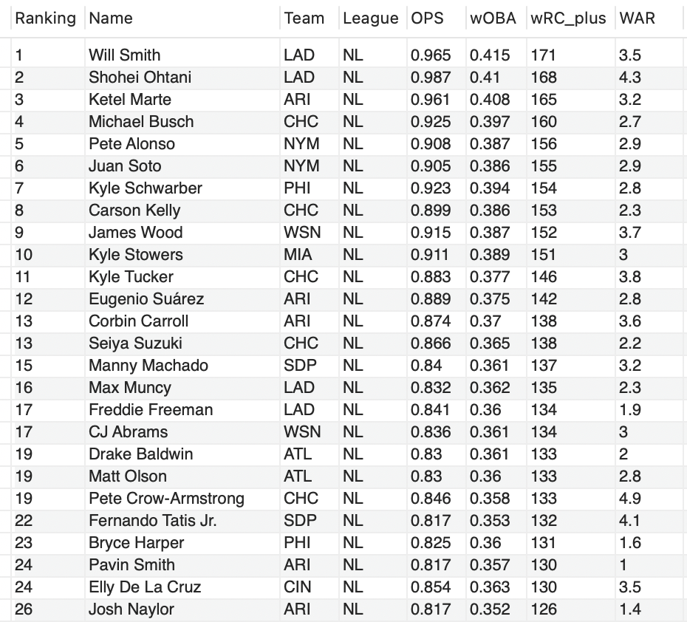
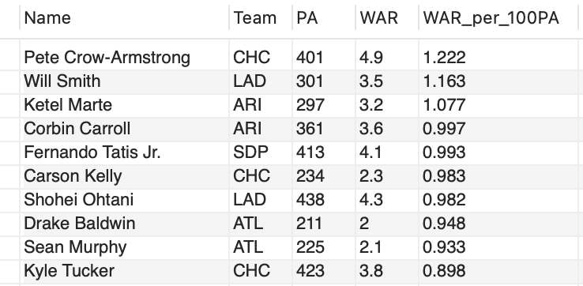
MVP Candidates: National League
NL Rankings by wRC+
1. Pete Crow-Armstrong
2. Shohei Ohtani
Crow-Armstrong is the best defender and base runner in baseball. Combine that with his power (25 home runs), and it’s clear why he leads the NL in WAR. The one knock on PCA is his very low walk rate of 4.5% (league average is 7.99%). Not walking leads to a lower OPS, wOBA, and wRC+ than other MVP candidates. However, his defense and base running being the best in baseball outweighs his low OBP, which is backed by his NL-best 4.9 WAR. He could be a 40 HR-40 SB, platinum glove player at the season’s end.x
Ohtani is having another awesome season at the plate, posting the second-highest wRC+ in the NL behind his teammate, Will Smith. The two-way phenom just returned to the mound, but he’s only pitching 1 inning per game. His limited pitching isn’t enough to catch PCA.
NL Rankings by WAR per 100 PA
3. Ketel Marte
Because Marte missed some due to injury, he has much less WAR than Crow-Armstrong and Ohtani. However, when the season ends, I expect Marte to maintain his rate stats (OPS and wOBA) and climb the WAR rankings. He accumulates over 1 WAR per 100 PA, which ranks 3rd in the NL.

Slide 13
Predicting the MVP
Using R Studio to predict the 2025 AL and NL MVP

Slide 14
My Model
Creates two separate tables, one for the American League and one for the National League.
These tables hold Fangraphs statistics from the 2014 – 2024 seasons.
Then, I normalized WAR, wRC+, wOBA and OPS, so I can assign weights and produce an appropriate score for each MVP candidate. These 4 stats are either relative to the league average (wRC+), a calculated percentage (OPS and wOBA), or a more complicated formula (WAR). To clean up the stats, I normalized them.
This produces a score for each MVP candidate, which is displayed by a bar chart. There is a chart for the AL, NL, and MLB altogether, so I can compare the candidates from both leagues.
The weights I assigned are:
WAR: 0.4
wRC+: 0.35
wOBA: 0.15
OPS : 0.1

Slide 15
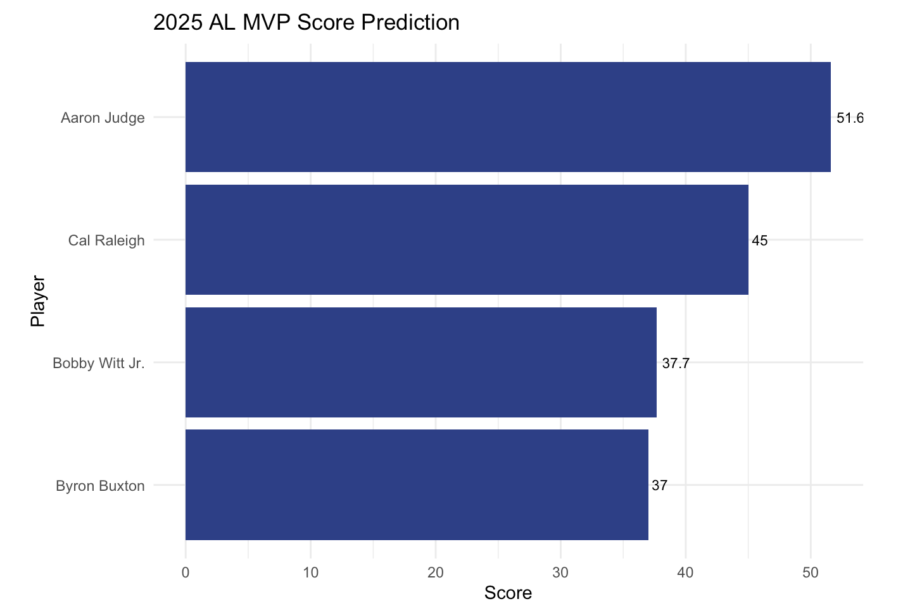
AL MVP: Aaron Judge
No surprise here, Judge leads in all 4 major categories by a wide margin, scoring 51.6 on my model. Barring a poor second half of the season, Judge will be taking home his 3rd MVP.

Slide 16
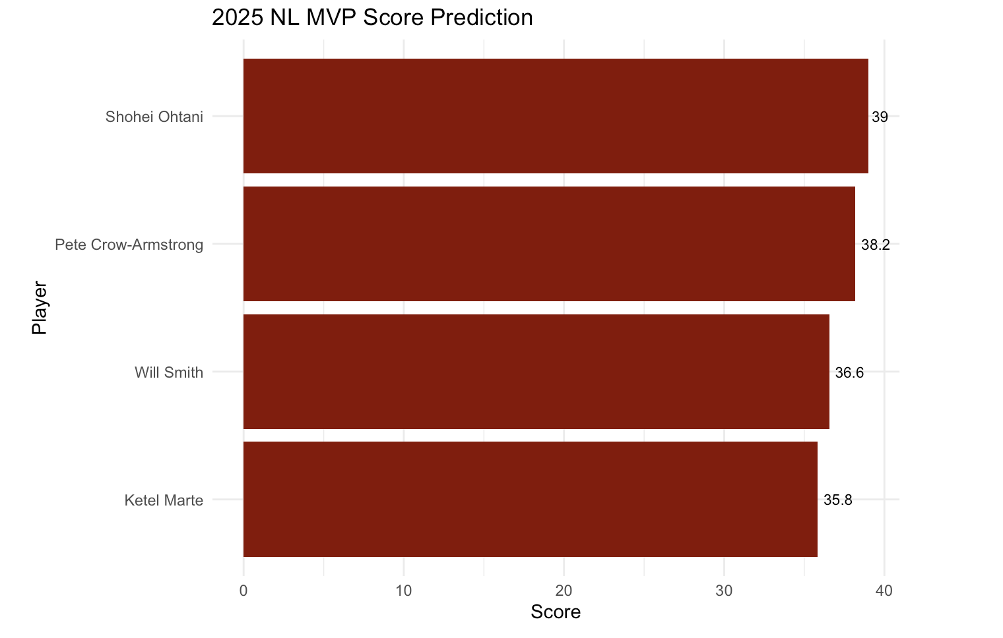
NL MVP: Shohei Ohtani
The NL MVP race is much closer, but Ohtani takes it over Pete Crow-Armstrong. I picked Crow-Armstrong because of the WAR difference, but Ohtani leads the NL in many offensive categories, so the model favors him. It will be close, but Shohei Ohtani will take home his 4th MVP this season.

Slide 17
Concluding Thoughts
Baseball has evolved into such a statistically-driven sport that correctly using key metrics is essential for predicting performance and evaluating players and teams. The most innovative, analytical organizations are consistently the most successful in today’s game. This project demonstrates how data can guide us beyond our own bias, providing a clearer, evidence-based view of who truly deserves recognition and awards. By building an MLB database and building a model to identify the MVP, I’ve shown how numbers can shape a more insightful approach to baseball’s biggest award.

Slide 18
Additional Links
LinkedIn: https://www.linkedin.com/in/evan-adinolfe/
GitHub: https://github.com/evanadinolfe
Email: evanadinolfe@gmail.com

